Slide 1
Introduction
Regression analysis of price from over 27,000 different fuel generations crude oil data. The data was thoroughly cleaned, preprocessed, and modeled using three different algorithms (xgboost, catboost and KNeighbor).
Among these algorithms, the best-performing one was selected for deployment and future use.

Slide 2
Problem statement and stakeholders
The problem statement is to predict the actual price of cruel oil to the public
Potential stateholders include:
Government entities: Nigerian Ministry of Power, Nigerian Electricity Regulatory Commission (NERC), Nigerian National Electricity Management Services Agency (NEMSA)
Electricity generation companies (GenCos)
Electricity distribution companies (DisCos)
Renewable energy companies
International organizations and donors

Slide 3
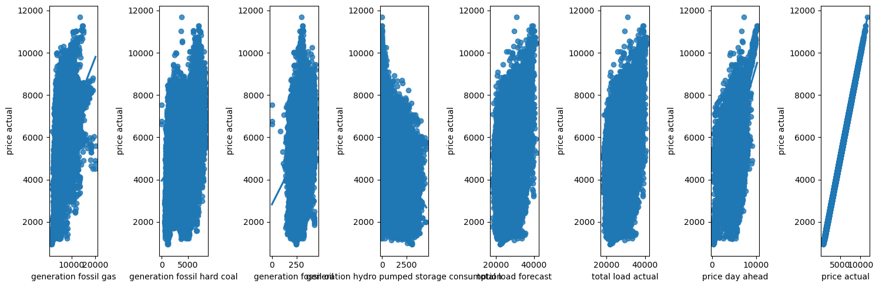
Scatter plot

Slide 4
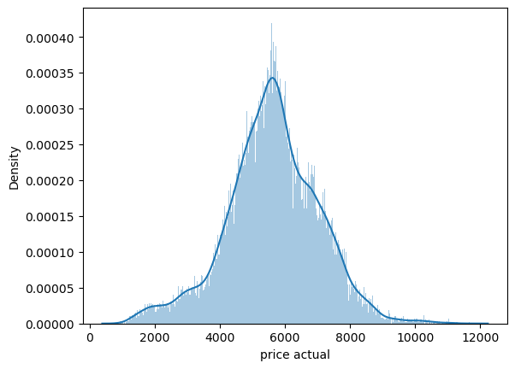
Distribution plot of price

Slide 5
Metrics
Root Mean Square Error(RMSE): This is the metrics that was used for the project. A lower RMSE indicates better predictive accuracy, as it means the predicted values are closer to the actual values.
k-nearest neighbors (KNN) performs well in using PSA and Gridsearchcv having a low RMSE compared to catboost and xgboost algorithm.

Slide 6
Strength (KNN)
KNN is a non-parametric algorithm, which means it does not make assumptions about the underlying data distribution. This makes KNN suitable for a wide range of datasets, including those with complex or non-linear relationships between features.
Ability to handle noisy data and outliers.
KNN is a versatile algorithm that can be used for both classification and regression tasks.

Slide 7
Limitations
Lack computational efficiency
Sensitivity to hyperparameter tuning

Slide 8
Recommendation
Since KNN was the one that performs well, it will be advisable to deployed it

